Slide 1
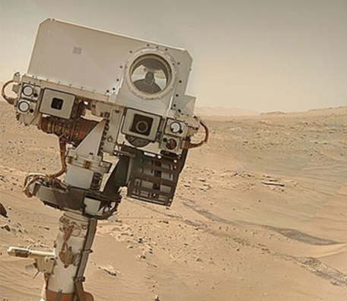
NAVCAMS
GROUP-7
JAGWANI DHARMESH
POSHIYA RAVIKUMAR
KHESKHANI JUGAL
MISTRY KISHAN

Slide 2
OUTLINE
INSTRUMENT OBJECTIVE
INSTRUMENT OVERVIEW
CONSTRAINTS
COMMANDS
HOW DOES IT WORK
WHAT WE DID ?
HOW WE DID?
CODE
DEMO

Slide 3
INSTRUMENT OBJECTIVE
To support the operation of the rover on the surface of Mars by acquiring images of the terrain and landscape.
To acquire images for support of auto-navigation, robotic arm operations, mobility planning (wheel sink age and obstruction), and pointing of the ChemCam and Mastcam.
To investigate the landing sites at cm/pixel resolution.

Slide 4
To acquire images of the morphology of rocks and soil in order to
provide clues about past geologic processes
To measure the distribution of rocks and soil around the rover as it moves from site to site.

Slide 5
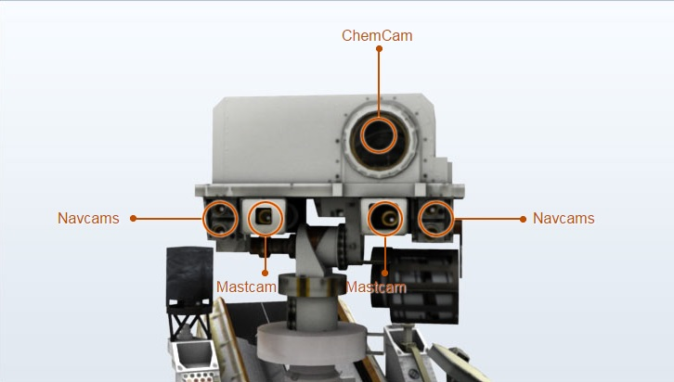
INSTRUMENT OVERVIEW

Slide 6
INSTRUMENT OVERVIEW (contd.)
The Mars Science Laboratory (MSL) rover carries 4 Navigation Cameras.
Each Navcam pair is separated by a 42.4cm. Each camera weighs 220 gms.
It produces 1024 x 1024 pixel images.
The Navcams also have the capability for onboard image processing.
It uses approximately 2.2 Watts of power when the heater is OFF.
It uses 3.5 W of power when heater is ON.

Slide 7
INSTRUMENT OVERVIEW (contd.)
OPTICS :
The Navcams have f/12 cameras with a 14.67 nm focal length.
The Navcam optics are f-theta fisheye lenses with 45 degree x 45 degree horizontal/vertical field of view and a 67 degree diagonal field of view.
The nominal exposure time for a noontime image on Mars is approximately 0.25 seconds.
Navcam camera ranges from 0.5 meters to infinity, with a hyper focal distance of 1.0 meters.

Slide 8
CONSTRAINTS
The rover should not be moving while taking pictures.
The minimum operating temperature of 218 K (-55.15 C).
Operating temperatures ranging from 218 K and 278 K.( -55 C and 5 C.)
Robotic arm has to be at its default position.

Slide 9
COMMANDS
NCAM_TURN_ON : It will turn ON the cameras.
NCAM_TURN_OFF : It will turn OFF the cameras.
NCAM_CAPTURE: Take a random image from a set of images and parse it in a JSON file.
NCAM_CLICK : Start the webcam, click a picture, convert it to gray scale and parse it in a JSON file.

Slide 10
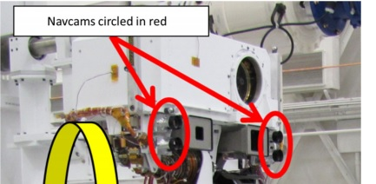
HOW DO NAVCAMS WORK ?

Slide 11
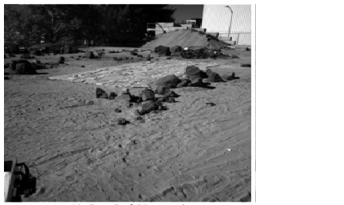
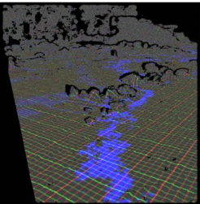
HOW DO NAVCAMS WORK ?
-RAW IMAGES TAKEN BY NAVCAM
-XYZ CARTESIAN LOCATION
OF EACH PIXEL

Slide 12
WHAT WE DID ?
UNDERSTANDING ABOUT MARS ROVER AND MAINLY ABOUT NAVCAMS
CREATING
A SERVER
CREATING
A CLIENT
REQUIREMENTS
GATHERING
PREPARING
COMMANDS
TESTING

Slide 13
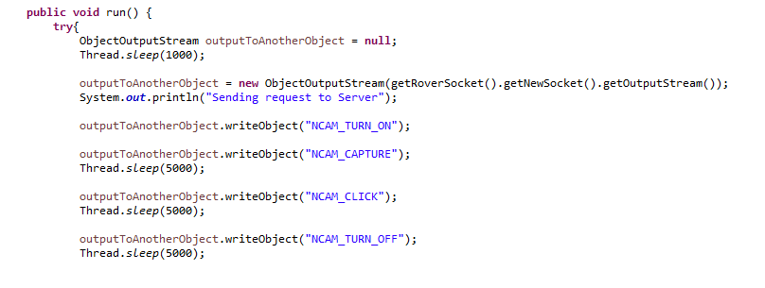
HOW WE DID ?
client

Slide 14
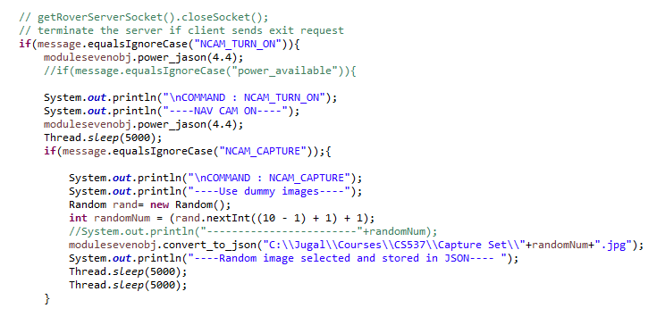
on & capture

Slide 15
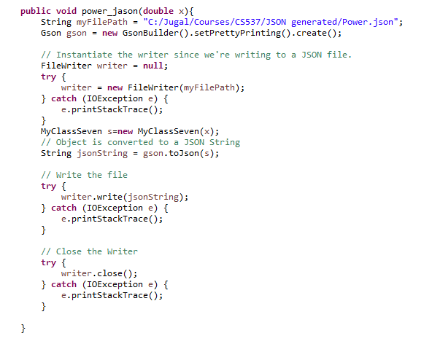
power json

Slide 16
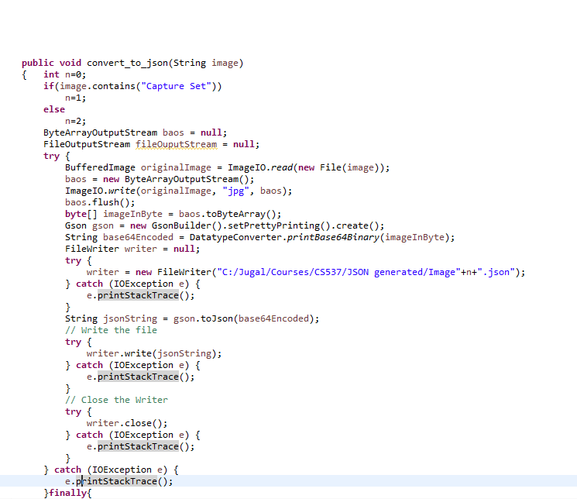
convert to json

Slide 17
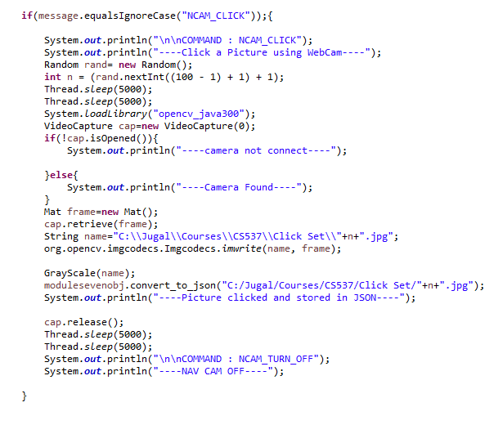
click

Slide 18
DEMO

